Slide 1
Sentiment Analysis with Machine Learning: Uncovering Emotions from Textual Data
Presented by: Warad Umesh Kadu
Guided By: Dr. Sheetal Dhande

Slide 2
Content
Introduction
What is Sentiment Analysis?
Sentiment Analysis Working
Applications
Challenges in Sentiment Analysis
Advantages
Disadvantages
Conclusion

Slide 3
Introduction
Sentiment Analysis is a data-driven approach to uncovering emotions and opinions from textual data.
In the digital era, textual data is abundant and contains valuable information about human emotions and opinions.
Sentiment Analysis enables businesses and organizations to make data-driven decisions and improve customer experiences.

Slide 4
What is Sentiment Analysis?
Sentiment Analysis, also known as Opinion Mining, is the process of determining emotions and opinions expressed in textual data.
It involves using Machine Learning and Natural Language Processing (NLP) techniques to classify text as positive, negative, or neutral.
Applications of Sentiment Analysis: Customer feedback analysis, social media monitoring, market research, brand reputation management, and more.

Slide 5
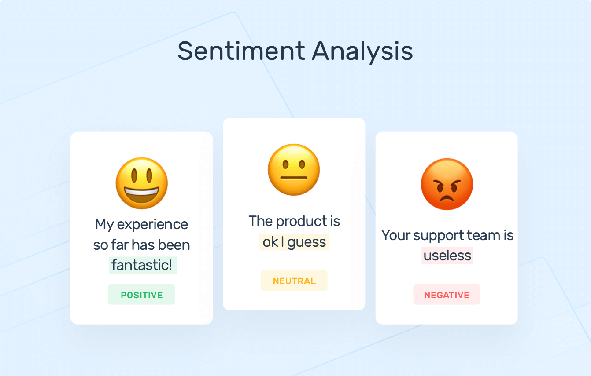

Slide 6
Sentiment Analysis Working
Understanding Text: The first step is to gather the text data that you want to analyze. This can be in the form of customer reviews, social media posts, news articles, or any other text-based content.
Text Preprocessing: The collected text data is preprocessed to clean and prepare it for analysis. This involves removing irrelevant information, handling special characters, converting text to lowercase, and other steps to standardize the text.
Sentiment Classification: Sentiment classification, also known as sentiment analysis or opinion mining, is a subfield of natural language processing (NLP) that involves determining the sentiment expressed in a piece of text. The primary goal is to classify the sentiment as positive, negative, or neutral.

Slide 7
Sentiment Analysis Working
Model Training: Machine learning models are trained on labeled data, where the sentiment of each piece of text is known. Common algorithms for sentiment analysis include Naive Bayes, Support Vector Machines (SVM), and deep learning models such as recurrent neural networks (RNNs) and transformers like BERT.
Sentiment score: A sentiment score in sentiment analysis represents the numerical measurement or quantification of the sentiment expressed in a piece of text. The sentiment score is typically associated with a specific sentiment category, such as positive, negative, or neutral. The score helps in understanding the intensity or polarity of sentiment within the given text.

Slide 8
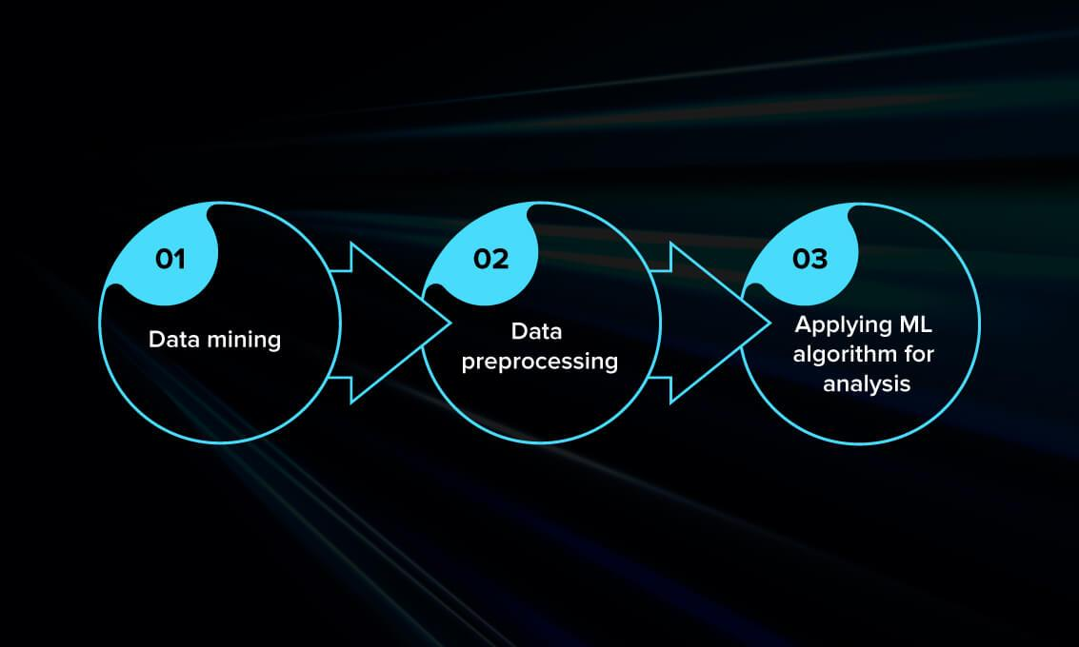

Slide 9


Application
E-commerce Product Reviews: Analyzing customer reviews to gauge product satisfaction and identify areas for improvement.
Customer Feedback and Support: Monitoring customer feedback to address issues and enhance customer satisfaction.
Political Sentiment Analysis: Analyzing public opinions and sentiments during political campaigns and elections .

Slide 10

Challenges in Sentiment Analysis
Ambiguity in Sentiment: Handling cases where sentiment is difficult to interpret, such as sarcasm or irony.
Language and Cultural Variations: Addressing diverse languages and cultural nuances in sentiment analysis.
Data Bias: Dealing with biased datasets that may affect sentiment analysis results.

Slide 11
Advantages
Automation: Automates the process of analyzing emotions from large volumes of text.
Efficiency: Processes data at a rapid pace, saving time compared to manual analysis.
Cost-Effective: Reduces the cost associated with manual sentiment analysis

Slide 12
Disadvantages
Lack of Context Understanding: May struggle to understand context, leading to misinterpretations.
Over-reliance on Training Data: The model's accuracy heavily depends on the quality and representativeness of the training data.
Difficulty with Sarcasm and Irony: May have challenges in identifying nuances like sarcasm and irony in text.

Slide 13
Conclusion
Recap of Sentiment Analysis as a powerful tool to understand emotions and opinions from textual data. Versatile applications in various industries for data-driven decision making.
sentiment analysis powered by machine learning offers a powerful and efficient means of uncovering emotions from textual data. The advantages, including automation, efficiency, and scalability, position sentiment analysis as a valuable tool across various industries. Real-time insights and cost-effectiveness make it particularly advantageous for businesses and organizations aiming to stay responsive in dynamic environments.
However, it is essential to acknowledge the challenges and limitations associated with sentiment analysis.

Slide 14
Thank you !

